Slide 1
Permaculture Introduction
“You never change things by fighting the existing reality. To change something, build a new model that makes the existing model obsolete.” –Buckminster Fuller

Slide 2
The Prime Directive and Three Ethics
"The only ethical decision is to take responsibility for our own existence; and that of our children." -Bill Mollison.
Care of the Earth
Care of People
Return of Surplus to the first two. (Set limits to population and consumption).

Slide 3
Concepts and Themes in Design

Slide 4
Laws and Principles
Observe and Interact
Law of Return – Whatever we take we must replace. (I.E. Soil fertility, nitrogen, potassium, carbon etc)
Work with rather than against nature – nature will often put “weeds” of all types in our systems and our lives in general. Figure out why they’re there, and what you can use them for.
The Problem is the solution – Finding ways to turn a negative situation into a positive one, or even the very solution can be in the problem itself. Example: You have a long commute, so you start listening to business podcasts on the way, thus leading to you creating a business and getting free of the commute.
Make the least change for the greatest possible effect.

Slide 5
Types of Resources
Unaffected by use – Oxygen that you breathe, turns into CO2, consumed by plants.
Increase with modest use. – Grazing
Disappear or degrade if not used. – Un-harvested fruit on a fruit tree
Reduced by use. – Finite metals, oil, etc.
Pollute or destroy with use – Burning fuels such as oil or nuclear reactants.
Pollution is a sign of an overabundance of a resource.

Slide 6
Energy
Get as much use out of a thing or resource as possible.
If water flows on your property, try to make it take the slowest, longest path possible to reduce erosion and get the most use out of it while its on your property (swales, dams, etc)
Stack functions. – Everything should have as many uses as possible. This is a principle both for survivalism and permaculture. The roof on your house can shield you from the weather, used as a hard surface to collect rainwater, and serve as a place to put solar panels or other energy harvesting systems.
Cycles – Most systems have a cycle from pioneering through climax to diminishment. They will produce different yields along the way. Corn for example, produces shade, food yield, and then decays into carbon again.

Slide 7
Note about diversity:
Don’t add diversity and complexity for the sake of diversity and complexity alone.
Each element in your system should be there because its either naturally occurring or you chose to put it there.
Diversity can add to stability, i.e. if one crop fails hopefully the others will make up for it. Or one element can reinforce another, such as rabbits fertilizing the garden, and them taking some of the harvest.

Slide 8
Methods of Design

Slide 9
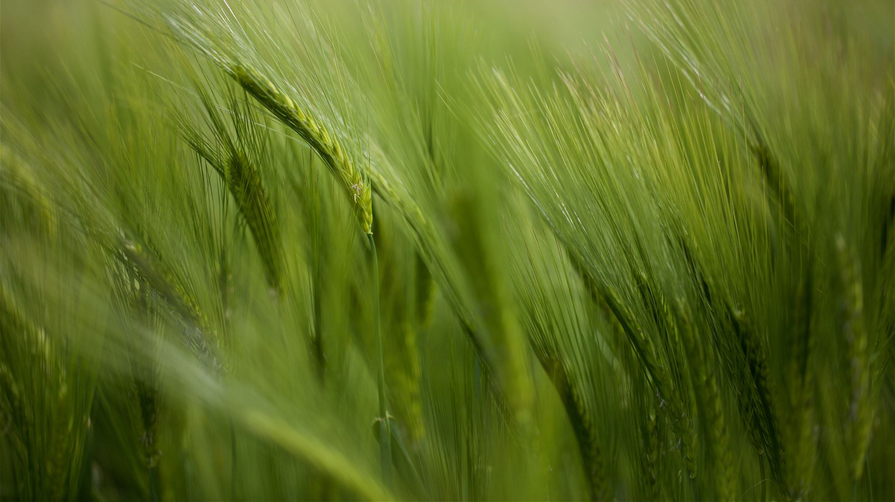
Components of Design
Site Components; water, earth, landscape, climate, plants, animals…
Social Components; People, Culture, Economy, Legal system.
Energy Components, Technologies, Structures, Tools etc
Abstract Components; Ethics, Timing, Data.
Each element has input needs, (has a behavior if its living), and produces an output. Chickens for example need food, water, shelter, calcium supplements, dust for dust baths. Behaviors are eating, excreting, scratching, hunting insects etc. Outputs are manure, feathers, eggs and when fully harvested, meat.

Slide 10
Zone and Sector Analysis
Zones are concentric “circles” around your central dwelling that represent usage in time. (in reality, its never a circle)
Sectors are directional sections from which outside elements can flow into your system (sunlight, traffic noise, a good view, dust etc)
Zone 0 – Inside the home.
Zone 1 – Area which you’re likely or necessarily go to every day. Kitchen garden, chickens, etc should be placed there. Most urban homes are 100% zone 1.
Zone 2- Main crops beds, orchards, ranging animals.
Zone 3 – Broad scale farming.
Zones 4 – 5 Line is blurry, 5 is specifically unmanaged wooded or natural area, where zone 4 is slightly managed (mushroom farm, woodlot, etc)

Slide 11
Patterns
Patterns are a huge part of permaculture, but the breadth of the subject is so wide it would fill textbooks.
Some simple patterns
Spiral pattern as used in an herb spiral.
Swales along contour, capturing the natural pattern of the land.
Dendrite pattern – branching, think of a tree or river.
The point of patterns is to observe them and see how you can use them effectively. Patterns create edges, which are the boundaries between 2 medium. Edges are often the most productive places in a system.

Slide 12
Meat and Po Ta Toes
Did someone say, Taters?

Slide 13
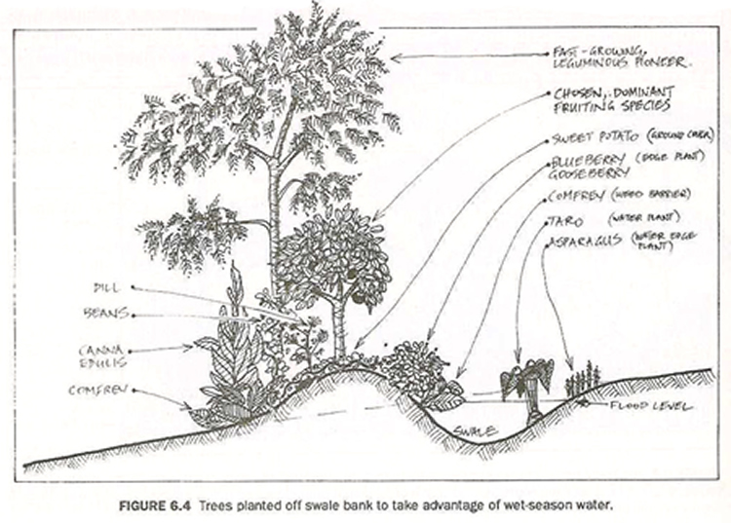
Some specific techniques in the permaculture toolbox.
Swales. A ditch on contour. Contour is the level line on a piece of land. The ditch runs parallel with the level, and the mound of dirt goes downhill. This lets water slowly seep across the landscape through the soil rather than causing erosion.

Slide 14
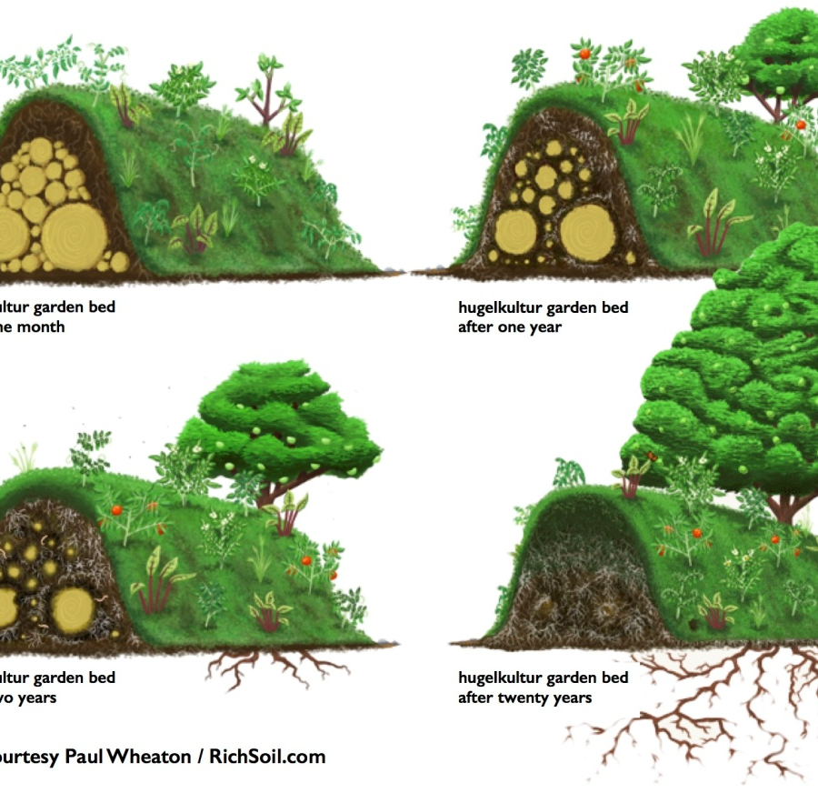
Hugelkultur
A Hugelkulture bed is a wood cored, high bed. The wood absorbs water and breaks down with fungus, providing a water sponge and nutrient silo for plants to thrive.

Slide 15
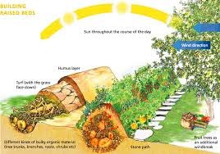
Hugelkulture and Wood Core Beds

Slide 16
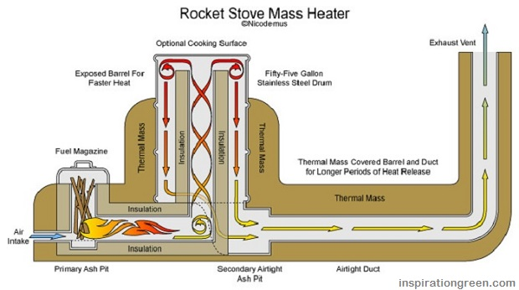
Rocket Mass Heater
Rocket mass heaters burn wood efficiently by burning it very hot and with maximum combustion. The exhaust isnt very smoky at all and most of the energy is converted to heat. The thermal mass absorbs the heat and radiates it throughout the day.

Slide 17
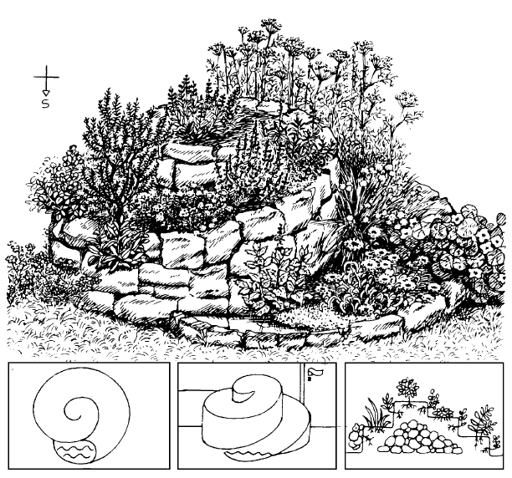
Herb Spiral
Driest loving herbs on top, wetter loving herbs down from there. Aesthetic and functional design

Slide 18
Time and Function Stacking
Time stacking is placing elements at the appropriate times so that they will be matured when other elements need them. Like planting a three sisters garden (corn squash and beans) by letting the corn grow a bit first, then getting the beans to grow up the stocks, then planting squash for shade.
Function stacking is multiples uses for a single element.
The cross section of both time and function stacking is where the most efficiency comes into play.

Slide 19
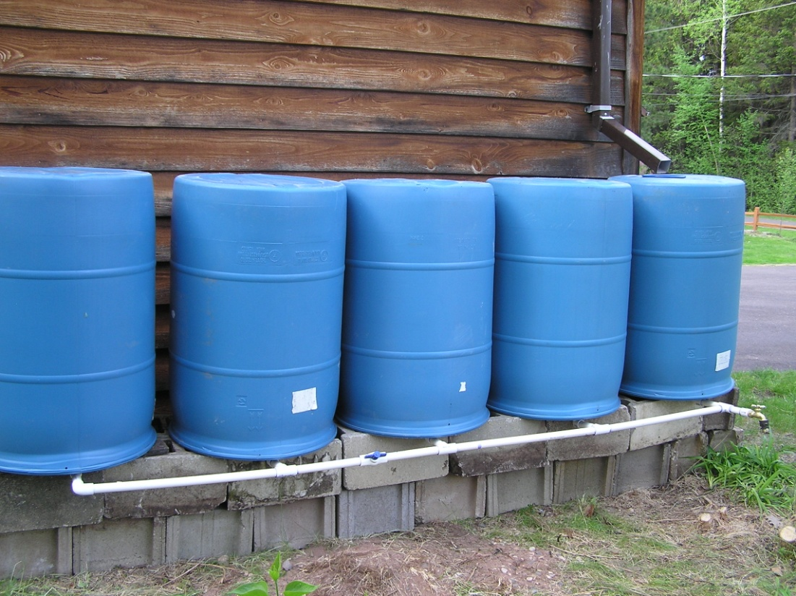
Rain Barrels/Ponds
Collecting rainwater off your roof and storing it in a system of rain barrels is a great way to reduce your water usage (yes, even in the desert).
Be sure that the bottom of the barrel is as high as possible, higher than the highest point you want to run water to.

Slide 20
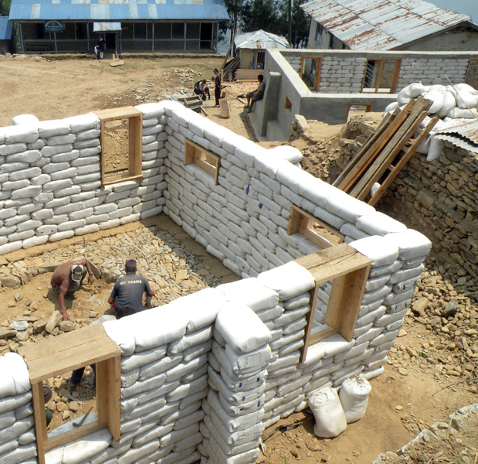
Earth Bag construction
Cheap materials but high labor cost.
Very high insulation and storm resistance.
Renewable except for the bags.

Slide 21
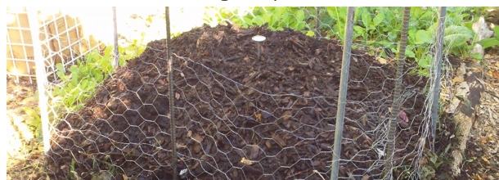
Composting
A friend of mine has a class on composting at https://homefoodsystems.com/courses/simplified-bioreactor-composting/
Generally need a cubic meter of brown and green material to get a good compost started. Turn and water regularly.

Slide 22
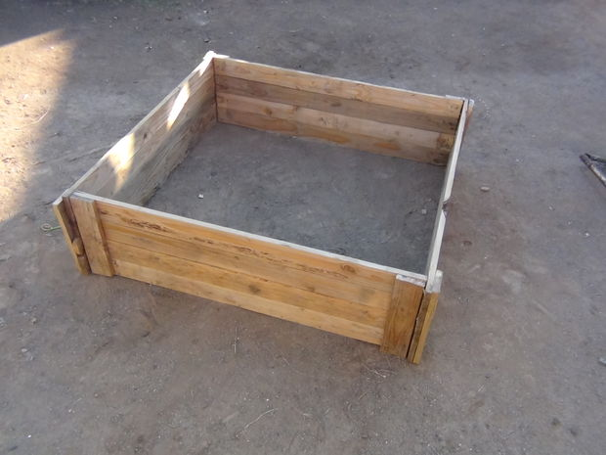
Raised Beds from reclaimed pallets
http://www.instructables.com/id/How-to-make-a-raised-bed-garden-box-from-wood-pall/

Slide 23
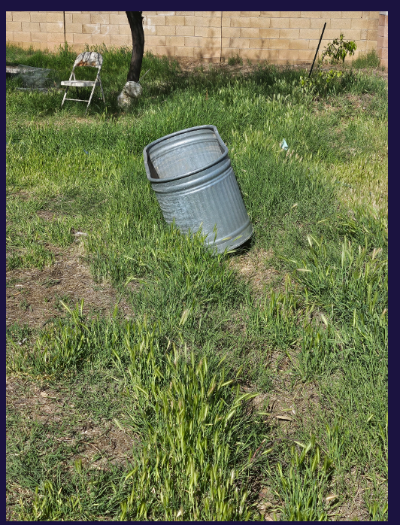
Before and After – my property

